Slide 1
Topic9: Density-based Clustering
DBSCAN
DENCLUE
Remark: “short version” of Topic9

Slide 2
Density-Based Clustering Methods
Clustering based on density (local cluster criterion), such as density-connected points or based on an explicitly constructed density function
Major features:
  Discover clusters of arbitrary shape
  Handle noise
  One scan
  Need density parameters
Several interesting studies:
  DBSCAN: Ester, et al. (KDD’96)
  DENCLUE: Hinneburg & D. Keim (KDD’98/2006)
  OPTICS: Ankerst, et al (SIGMOD’99).
  CLIQUE: Agrawal, et al. (SIGMOD’98)

Slide 3
DBSCAN
(http://www2.cs.uh.edu/~ceick/7363/Papers/dbscan.pdf )
DBSCAN is a density-based algorithm.
  Density = number of points within a specified radius r (Eps)
  A point is a core point if it has more than a specified number of points (MinPts) within Eps
    These are points that are at the interior of a cluster
  A border point has fewer than MinPts within Eps, but is in the neighborhood of a core point
  A noise point is any point that is not a core point or a border point.

Slide 4

DBSCAN: Core, Border, and Noise Points

Slide 5
DBSCAN Algorithm (simplified view for teaching)
Create a graph whose nodes are the points to be clustered
For each core-point c create an edge from c to every point p in the ε-neighborhood of c
Set N to the nodes of the graph;
If N does not contain any core points terminate
Pick a core point c in N
Let X be the set of nodes that can be reached from c by going forward;
  create a cluster containing X∪{c}
  N=N/(X∪{c})
Continue with step 4
Remark: points that are not assigned to any cluster are outliers;

Slide 6


DBSCAN: Core, Border and Noise Points
Original Points
Point types: core, border and noise
Eps = 10, MinPts = 4

Slide 7

When DBSCAN Works Well
Original Points
Clusters
Resistant to Noise
Can handle clusters of different shapes and sizes

Slide 8



When DBSCAN Does NOT Work Well
(MinPts=4, Eps=9.75).
Original Points
Varying densities
High-dimensional data
(MinPts=4, Eps=9.92)

Slide 9
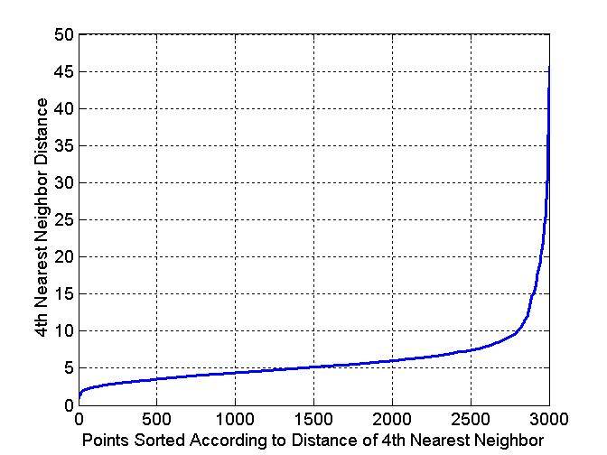
DBSCAN: Determining EPS and MinPts
Idea is that for points in a cluster, their k^{th} nearest neighbors are at roughly the same distance
Noise points have the k^{th} nearest neighbor at farther distance
So, plot sorted distance of every point to its k^{th} nearest neighbor
Core-points
Non-Core-points
Run K-means for Minp=4 and not fixed

Slide 10
Complexity DBSCAN
Time Complexity: O(n²)—for each point it has to be determined if it is a core point, can be reduced to O(n*log(n)) in lower dimensional spaces by using efficient data structures (n is the number of objects to be clustered);
Space Complexity: O(n).

Slide 11
Summary DBSCAN
Good: can detect arbitrary shapes, not very sensitive to noise, supports outlier detection, complexity is kind of okay, beside K-means the second most used clustering algorithm.
Bad: does not work well in high-dimensional datasets, parameter selection is tricky, has problems of identifying clusters of varying densities (→SSN algorithm), density estimation is kind of simplistic (→does not create a real density function, but rather a graph of density-connected points)

Slide 12
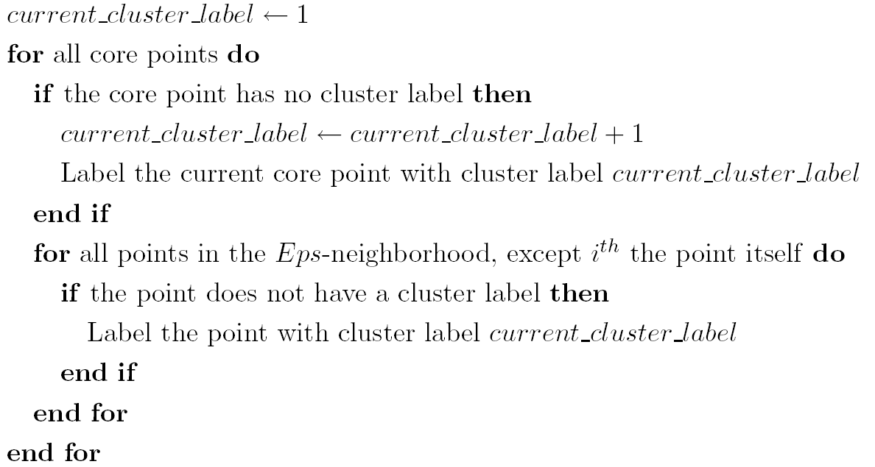
DBSCAN Algorithm Revisited
Skip!
Eliminate noise points
Perform clustering on the remaining points:

Slide 13
DENCLUE (http://www2.cs.uh.edu/~ceick/ML/Denclue2.pdf )
DENsity-based CLUstEring by Hinneburg & Keim (KDD’98)
Major features
  Solid mathematical foundation
  Good for data sets with large amounts of noise
  Allows a compact mathematical description of arbitrarily shaped clusters in high-dimensional data sets
  Significant faster than existing algorithm (faster than DBSCAN by a factor of up to 45) ????????
  But needs a large number of parameters

Slide 14
Denclue: Technical Essence
Uses grid cells but only keeps information about grid cells that do actually contain data points and manages these cells in a tree-based access structure.
Influence function: describes the impact of a data point within its neighborhood.
Overall density of the data space can be calculated as the sum of the influence function of all data points.
Clusters can be determined using hill climbing by identifying density attractors; density attractors are local maximal of the overall density function.
Objects that are associated with the same density attractor belong to the same cluster.

Slide 15
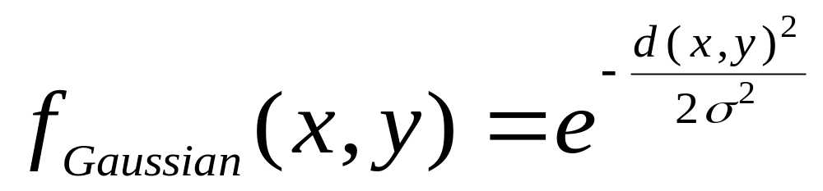
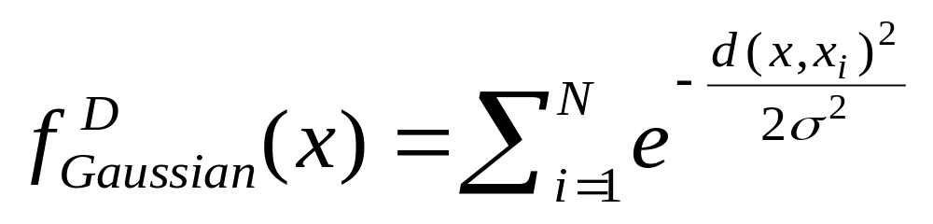

Gradient: The steepness of a slope
Example

Slide 16
Example: Density Computation
D={x1,x2,x3,x4}
f^{D}_{Gaussian}(x)= influence(x,x1) + influence(x,x2) + influence(x,x3)
+ influence(x4)=0.04+0.06+0.08+0.6=0.78
x1
0.04
x3
y
0.08
x2
x4
0.06
x
0.6
Remark: the density value of y would be larger than the one for x

Slide 17



Density Attractor

Slide 18

Examples of DENCLUE Clusters

Slide 19
Basic Steps DENCLUE Algorithms
Determine density attractors
Associate data objects with density attractors using hill climbing
Possibly, merge the initial clusters further relying on a hierarchical clustering approach (optional; not covered in this lecture)

